Slide 1


Python Functions: Building Reusable Code
A beginner's guide to writing clean, efficient, and reusable Python code.

Slide 2

Why Functions Matter
Write Once, Use Anywhere
Cleaner Code
Break big problems into small, named, testable pieces that are easier to understand.
Package logic once and call it as many times as needed — no repetition required.
The Golden Rule
If you're copy-pasting code, it belongs in a function.

Slide 3

Defining a Function with def
def greet(name):
print("Hello,", name)
greet("Alice")
# Hello, Alice
def function_name(parameters): — the keyword, name, and signature
Body is indented; Python uses indentation (not braces) to define scope
A function does nothing until it is called

Slide 4

Parameters: Positional & Default
Positional
Default
Arguments matched by order — position determines which value goes where.
Provide a fallback value when an argument is omitted at call time.
def greet(name, greeting):
print(greeting, name)
greet("Alice", "Hello")
def greet(name="World"):
print("Hello,", name)
greet() # Hello, World
greet("Bob") # Hello, Bob
Default parameters must always come after positional ones in the function signature.

Slide 5


Keyword Arguments
Pass arguments by name, in any order
Makes function calls self-documenting and less error-prone
Mix positional and keyword — positional args must come first
Keyword args make code readable at a glance — no more guessing what each argument means.
def connect(host, port, timeout=30):
print(f"Connecting to {host}:{port}")
connect(host="localhost", port=8080)
connect("localhost", port=8080, timeout=60)

Slide 6



*args and **kwargs
*args — Extra Positional Arguments
**kwargs — Extra Keyword Arguments
Combined Pattern
Use both together for maximum flexibility — a common pattern in logging utilities and decorators.
Collects any number of positional arguments into a tuple. Useful when the count is unknown at definition time.
Collects any number of keyword arguments into a dict. Great for flexible configuration or API wrappers.
def flexible(*args, **kwargs):
print(args, kwargs)
def total(*args):
return sum(args)
total(1, 2, 3, 4) # 10
def log(**kwargs):
for k, v in kwargs.items():
print(f"{k}: {v}")
log(user="Alice", level="INFO")

Slide 7

Return Values
return sends a value back to the caller; without it, Python returns None
A function can return multiple values as a tuple — return x, y
Early returns are valid — use them to handle edge cases cleanly
def divide(a, b):
if b == 0:
return None # early return
return a / b, a % b # tuple return
result, remainder = divide(10, 3)

Slide 8
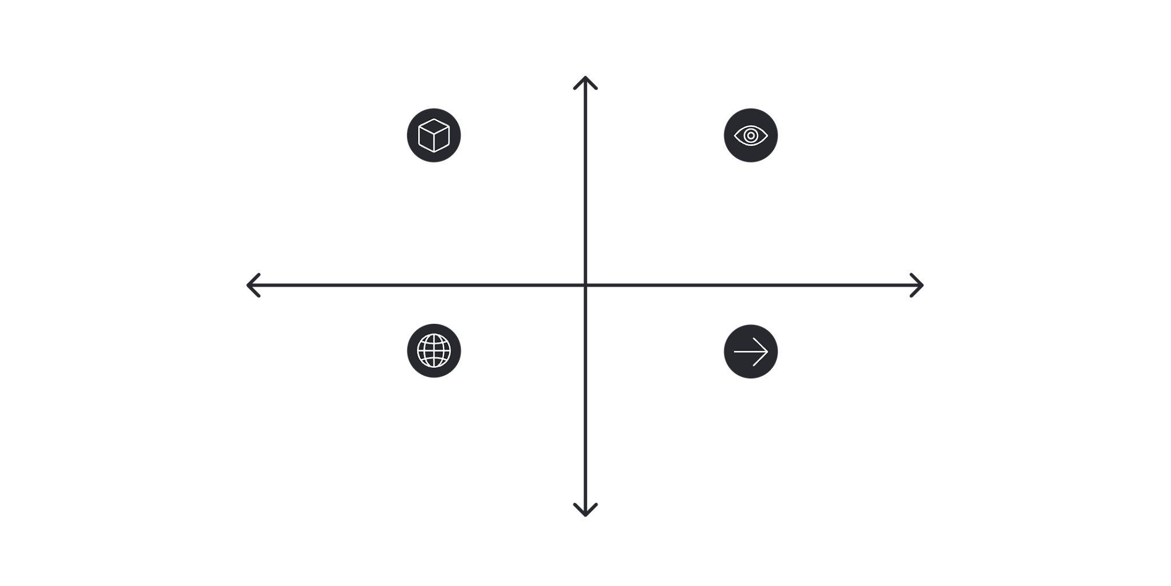

Scope: Local vs Global
In Practice
High Encapsulation
total = 100 # global
def add(x):
result = x + 10 # local
return result
def bad_update():
global total
total += 1 # works but avoid this!
Local: Function-only variables
Local Readable Internally
Writable with global
Not Writable Locally
Global: Module-wide variables
Global Readable Inside Functions
Low Encapsulation
Best practice: Avoid relying on globals — pass values as parameters and return results instead.
Think of scope as a one-way mirror — functions can see the outside world, but changes inside stay inside.

Slide 9

Docstrings: Document Your Functions
What is a Docstring?
A Good Docstring Describes:
A string literal on the first line of a function body. Accessible via help() and function.__doc__.
01
What it does
A one-line summary of the function's purpose.
def calculate_tax(amount, rate=0.2):
"""
Calculates tax for a given amount.
Args:
amount (float): The base amount.
rate (float): Tax rate (default 0.2).
Returns:
float: The tax owed.
"""
return amount * rate
02
Parameters
Name, type, and meaning of each argument.
03
Return value
What the function returns and its type.

Slide 10


Nested Functions
A function defined inside another function — only visible within the outer scope
Inner functions can access the outer function's variables (closure)
Useful for helper logic you don't want to expose globally
def make_multiplier(factor):
def multiply(x): # nested!
return x * factor # accesses outer var
return multiply
double = make_multiplier(2)
double(5) # 10
The inner multiply function "closes over" factor — this is a closure.

Slide 11

Practical: Build a Reusable Utility
Combine everything you've learned into one well-crafted function:
def format_report(title, *entries, separator="—", **metadata):
"""
Formats a text report with a title, entries, and optional metadata.
Args:
title (str): Report heading.
*entries: Variable number of report lines.
separator (str): Line divider character (default '—').
**metadata: Extra key-value pairs (e.g. author, date).
Returns:
str: Formatted report as a string.
"""
lines = [title, separator * 30]
lines.extend(entries)
for key, value in metadata.items():
lines.append(f"{key}: {value}")
return "\n".join(lines)
print(format_report(
"Sales Summary",
"Q1: $12,000", "Q2: $15,500",
author="Alice", date="2024-06"
))
Try calling it with different combinations of positional, keyword, and extra arguments to see the flexibility in action.

Slide 12




Key Takeaways
Control How Functions Are Called
Embrace Flexibility with *args / **kwargs
Document and Keep Scope Clean
Use positional, default, and keyword args to make your functions flexible and readable at the call site.
Use *args and **kwargs when the number of inputs isn't fixed — ideal for utilities, wrappers, and APIs.
Always write docstrings. Pass data in via parameters, return data out — avoid relying on global variables.
Next step: Refactor a repeated block from your own exercises into a clean, documented function using the patterns from this deck.

